Slide 1
Unit 1 Lesson12
operators , Operator precedence

Slide 2
Python Operators
Operators are used to perform operations on variables and values. In the example below, we use the + operator to add together two values
a = b + c OR x = y + 5
Python divides the operators in the following groups:
Arithmetic operators
Assignment operators
Comparison operators
Logical operators
Identity operators
Membership operators
Bitwise operators

Slide 3
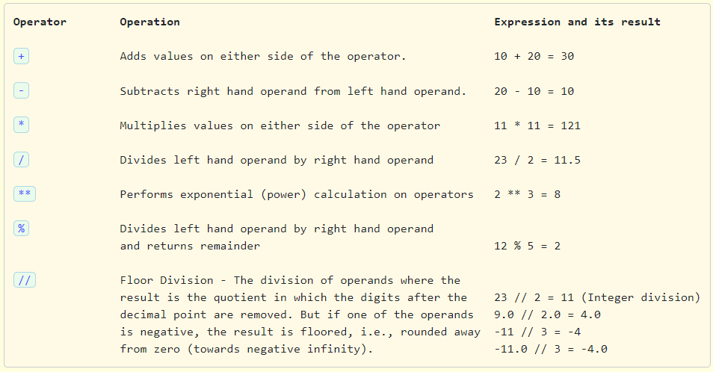

Slide 4
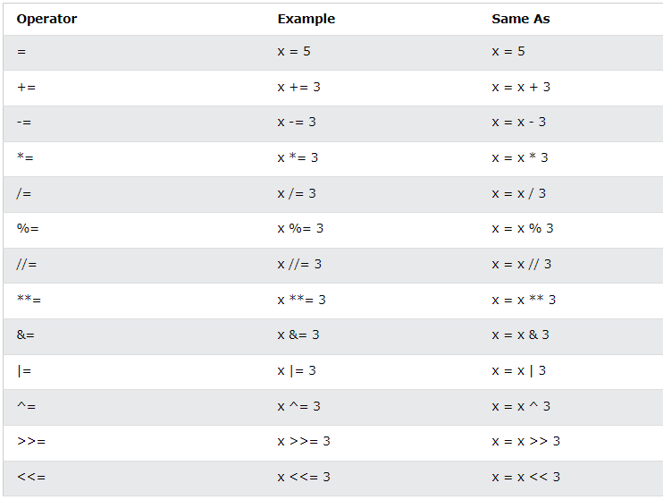

Slide 5
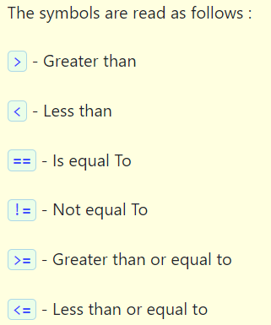
Comparison Operators
Python supports the following comparison operators. The result of these comparison operators is either True or False

Slide 6
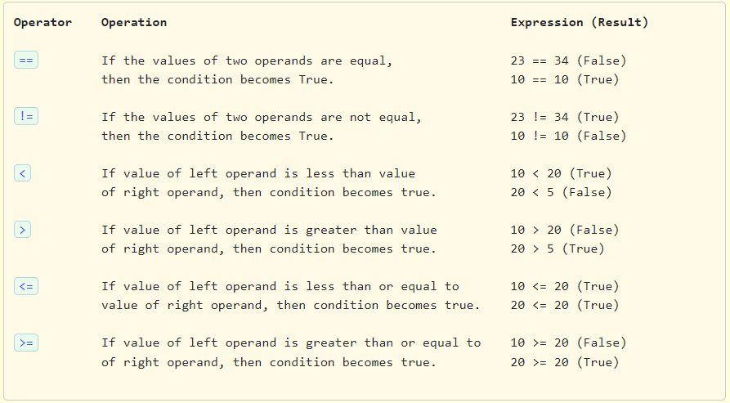

Slide 7
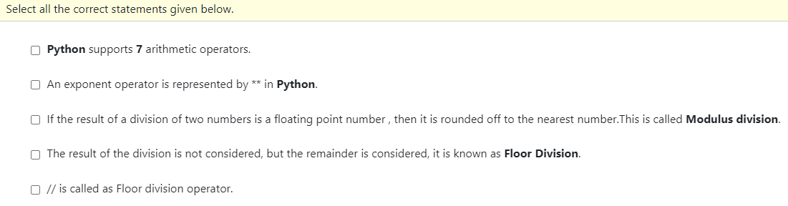

Slide 8
Which one of these is floor division?
a) / b) // c) % d) None of the mentioned

Slide 9
Which one of these is floor division?
a) / b) // c) % d) None of the mentioned

Slide 10
What will be the output of following code
x=125
y=13
x//=y
print(x)
a.125/13
b.10
c.9
d.9.62

Slide 11
What will be the output of following code
x=125
y=13
x//=y
print(x)
a.125/13
b.10
c.9
d.9.62

Slide 12
What is the answer to this expression, 22 % 3 is?
a) 7 b) 1 c) 0 d) 5

Slide 13
What is the answer to this expression, 22 % 3 is?
a) 7 b) 1 c) 0 d) 5

Slide 14
The divmod(dividend,divisor)
The divmod(dividend,divisor) function returns a tuple containing the quotient and the remainder, when argument1 (dividend) is divided by argument2 (divisor). The syntax of the divmod() function is :
divmod(x, y)
x - a non-complex number (numerator)
y - a non-complex number (denominator)
The divmod() returns (q, r) - a pair of numbers (a tuple) consisting of quotient q and remainder r
Note: If x and y are integers, the return value from divmod() is same as (x // y, x % y).
Note: If either x or y is a float, the result is (q, x%y). Here, q is the whole part of the quotient.
Understand the working of divmod() by the following examples :
Statement Result
print(divmod(8, 3)) (2, 2)
print(divmod(3, 8)) (0,3)

Slide 15
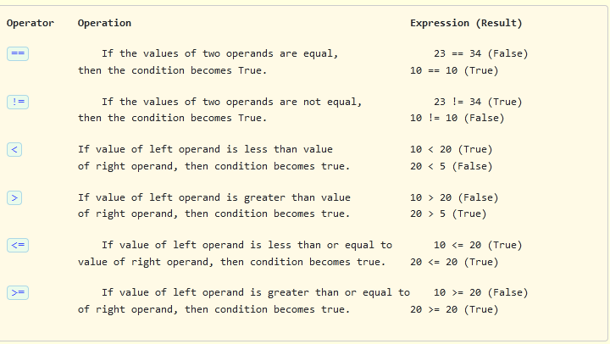
Comparison Operators
Python supports the following comparison operators. The result of these comparison operators is either True or False.

Slide 16
Write a program to understand the comparison operators in Python and perform the following operations >, <, ==, !=, <=, >= and print the result. Take two int inputs from the user.
For example, if the user gives the input as:
Enter num1: 40
Enter num2: 10
Sample Input and Output :
Is 40 greater than 10 = True
Is 40 less than 10 = False
Is 40 equal to 10 = False
Is 40 not equal to 10 = True
Is 40 less than or equal to 10 = False
Is 40 greater than or equal to 10 = True

Slide 17
Comparison operators with strings
All the comparison operators work on strings also. The result is either True or False. Python compares strings using Unicode value of the characters (lexicographical). The comparison is made taking the ordinal values of each character in the string and compare it with the ordinal values of the character at the same position in the other string. If the ordinal value of the character in the first string is greater than the ordinal value of the character in the second string, then the comparison stops and the first string is declared greater than the second string. The length of the string does not matter. In Python, the ordinal value of a character can be found using the ord() function, which takes the character as an argument.

Slide 18
Identify correct comparison operators
a)>>=
b)==
c)!=
d)Both b and c

Slide 19
Identify correct comparison operators
a)>>=
b)==
c)!=
d)Both b and c

Slide 20
which of the following is correct output for given expression?
x=20
x*=5 will print ?
a)20
b)100
c)5
d None of these

Slide 21
which of the following is correct for given expression?
x%=5
print(x)
a)6
b)5
c)1
d None of these

Slide 22
Python allows simple syntax for assigning same value to multiple variables as follows (chained assignment):
x=y=z=12
12 is assigned to x,y and z
Similarly, you can assign multiple values to multiple variables in a single statement:
a,b,c=12,45.67,”naman”
A will get value 12,b will get 45.67 and c will get “naman”

Slide 23
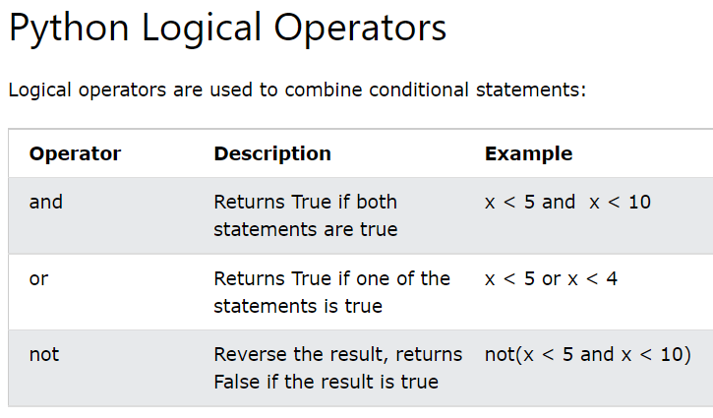

Slide 24
Identity operators
Every object has an identity, a type and a value. An object’s identity never changes once it is created, you may think of it as the object’s address in memory. The ‘is‘ operator compares the identity of two objects, the id() function returns an integer representing its identity (currently implemented as its address).
Returns the “identity” of an object. This is an integer which is guaranteed to be unique and constant for this object during its lifetime
Usually this is the address of the object in memory.
If two integer or string variables have the same value, they point to the same memory location
But this is not true with floating point numbers, lists, tuples and dictionaries.
An Identity operator is used to check the memory location of the operands and based on the memory location the result is returned.
The identity operators in Python are "is" and "is not".

Slide 25
Example
1. is: If two objects are in the same memory, then it means they are the same objects. So the result is True.
a = 10
b = 10
c = a is b
Here c is True.
Note: Small integers (-5 to 256 both included) are interned in Python since they are used so often.
It's an optimization. x = 5, y = 5, x is y => True because id(x) == id(y).
It's the same integer object which is reused. Works in Python since integers are immutable.
If you do x = 1.0, y = 1.0 or x = 9999, y = 9999, it won't be the same identity, because floats and larger ints aren't interned.

Slide 26
Example
is not: If two objects are in the different memory location , then it means they are the different objects and so not equal. So the result is False. c = a is not b
Here c is False.
Note : Two integers or strings with the same value point to the same memory location, but two floats or any other objects point to two different locations.

Slide 27
str1 = 'abcdef'
str2 = 'abcdef'
print(str1 is str2)
will be True
f1 = 78.98
f2 = 78.98
print(f1 is f2)
will be False.
f2 = f1
Now f1 is f2 will be True

Slide 28
Questions
Select the correct statement given below:
An identity can be changed once created.
Two strings with same value point to different locations.
id(object) is unique and Constant for an object during its lifetime.

Slide 29
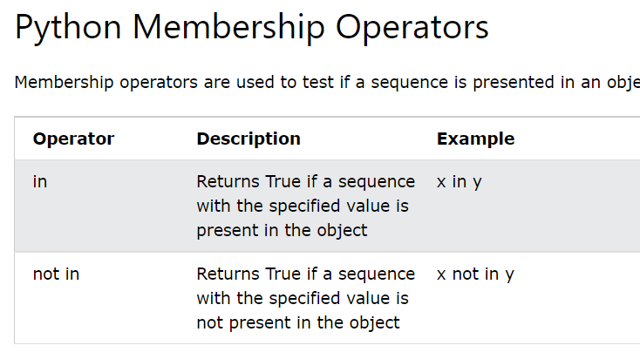

Slide 30
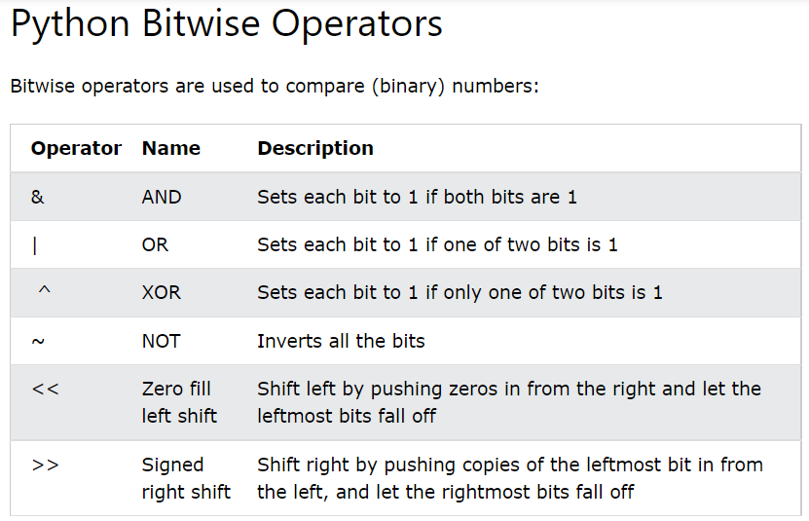

Slide 31
Python Bitwise Operators take one or two operands, and operate on them bit by bit, instead of whole. Following are the bitwise operators in Python
1. << (Left shift) - Multiply by 2 ** number of bits
Example: x = 12 and x << 2 will return 48 i.e. (12 * (2 ** 2)) This is similar to multiplication and more efficient than the regular method
2. >> (Right shift) - divide by 2 ** number of bits
Example: x = 48 and x >> 3 will return 6 i.e. (48 / (2 ** 3)) This is similar to division by powers of 2 (2, 4, 8, 16 etc.)
3. & (AND) - If both bits in the compared position are 1, the bit in the resulting binary representation is 1 (1 × 1 = 1) i.e. True; otherwise, the result is 0 (1 × 0 = 0 and 0 × 0 = 0) i.e. False.
Example : x & y Does a "bitwise and". If the bit in x and the corresponding bit in y are 1, then the bit in the result will be 1. otherwise it will be zero.
2 & 5 will result in zero because (010 & 101 = 000). 3 & 5 will result in 1 because (011 & 101 = 001)

Slide 32
4. | (OR) - If the result in each position is 0(False) if both bits are 0, while otherwise the result is 1(True).
Example : x | y Does a "bitwise or". If the bit in both operands is zero, then the resulting bit is zero. otherwise it is 1.
2 | 5 will result in 7 because (010 |101 = 111) and 3 | 5 will also result in 7 because (011 | 101 = 111)
5. ~ (NOT) - The bitwise NOT, or complement, is a unary operation that performs logical negation on each bit, forming the ones' complement of the given binary value. Bits that are 0 become 1, and those that are 1 become 0.
Example : ~ Returns the complement of x . If the bit is 1 it will become zero and if the bit is zero it will become 1.
~5 will result in 2 because (~101 = 010) and ~2 will become 5 because (~010 = 101). This is true only for unsigned integers.
6. ^ (Bitwise XOR) - If the comparison of two bits, being 1 if the two bits are different, and 0 if they are the same.
Example: Does a "bitwise exclusive or". If the bit in in either operands is 1, but not in both, then the resultant bit will be 1. Otherwise it will be 0.
5 ^ 3 will result in 6 because (101 ^ 011 = 110)

Slide 33
Problem:
Take two integers x and y as inputs from the console using input() function. For each bitwise operator ( >> , <<, &, |, ~, and ^ ), print to the console, the result of applying these operators on the two input integers as shown in the example.
Sample Input and Output:
Enter an integer value: 52
Enter an integer value: 20
52 >> 20 is ?
52 << 20 is ?
52 & 20 is ?
52 | 20 is ?
~ 52 is ?
52 ^ 20 is ?

Slide 34
Solution:
Enter an integer value: 52
Enter an integer value: 20
52 >> 20 is 0
52 << 20 is 54525952
52 & 20 is 20
52 | 20 is 52
~ 52 is -53
52 ^ 20 is 32

Slide 35
Problem:
Enter an integer value: 12
Enter an integer value: 3
12 >> 3 is ?
12 << 3 is ?

Slide 36
Solution:
Enter an integer value: 12
Enter an integer value: 3
12 >> 3 is 1
12 << 3 is 96

Slide 37
Operator precedence
Operator precedence is a predefined rule. It defines which operator has highest priority and an expression is evaluated based on operator priority. This is used when an expression has more than one operators with different precedence. For example, 50 + 30 * 10 is calculated as 50 + (30 * 10) = 350, and should not be calculated as (50 + 30) * 10 = 800. The operator precedence follows for all types of operators supported by Python (Arithmetic, Assignment, Comparison, Bitwise, Logical, Identity and Membership).

Slide 38
The rule of associativity is used when two operators of same precedence are in the same expression. Associativity can be either left to right or right to left. For example, as ‘*’ and ‘/’ have same precedence and their associativity is Left to Right, so the expression “100 / 10 * 10” is calculated as “(100 / 10) * 10”.

Slide 39
Question
Select the correct statements given below.
Operator precedence is performed based on priority of an operator.
Associativity is used when two operators of same precedence are in the same expression.
Associativity is only from Left to Right .
The operator precedence is only used on Arithmetic operators.

Slide 40
Operators
The operator precedence of Python operators is mentioned below. Please note the top row operators take the highest precedence and the operators in the same row have the same precedence (in this case the associativity is followed in an expression).
** Exponent
~ + - Complement, plus and minus(unary)
* / % // Multiply, divide, modulo and floor division
+ - Addition and subtraction
>> << Right and left bitwise shift
& Bitwise 'AND'

Slide 41
^ | Bitwise 'XOR' and regular 'OR'
<= < > >= Comparison operators
<> == != Equality operators
= %= /= //= -= += *= **= Assignment operators
is and is not are Identity operators
in and not in Membership operators
not, or, and are Logical Operators
This is how operator precedence is followed in any language. so we have an idea of operator precedence to get the right result. Below is a simple example using arithmetic operators and let us see the precedence followed. If you notice, * is calculated before +

Slide 42
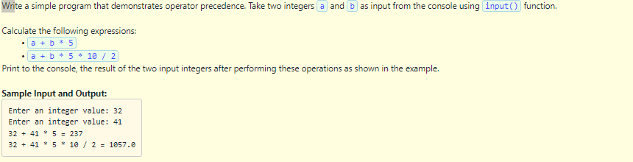
Question

